Slide 1
Machine Learning
Data Cleansing
Tomas Karpati MD tc.datascience@gmail.com
054-2002430

Slide 2
Data Cleansing
“All data of the real world are generally approximations, more or less close to the reality. Exactness only exists normally in theory or in mathematical abstractions. Thus, frequently, real data can be always improved, because they have always implicit a tolerance or acceptable error subjacent”
António Manuel Abreu Freire Diogo
University of Coimbra
Notes:
Point: internal errors or anomalies.
Contextual: periodical random measurement errors, external factors that interfere with measures
Collective: change in hose costs in europe before and after the euro.

Slide 3
Data Cleansing
The data cleansing process include the treatment of the data to achieve completeness and reduce the bias caused by errors on the data.
Data cleansing includes:
Treatment of outliers
Treatment of missingness

Slide 4
Outliers
Outliers are extreme values that deviate from other observations on data , they may indicate a variability in a measurement, experimental errors or a novelty.
Type of outliers:
Univariate
Multivariate

Slide 5
Outliers
Outliers can be also classified as:
Point outliers: are single data points that lay far from the rest of the distribution.
Contextual outliers: can be noise in data, such as background noise signals.
Collective outliers: can be subsets of “novelties” in data such as a signal that may indicate the discovery of new phenomena.
Notes:
Point: internal errors or anomalies.
Contextual: periodical random measurement errors, external factors that interfere with measures
Collective: change in hose costs in europe before and after the euro.

Slide 6
Outliers
Causes of outlier measures:
Data entry errors (human errors)
Measurement errors (instrument errors)
Experimental errors (data extraction or experiment planning/executing errors)
Intentional (dummy outliers made to test detection methods)
Data processing errors (data manipulation or data set unintended mutations)
Sampling errors (extracting or mixing data from wrong or various sources)
Natural (not an error, novelties in data)
Notes:
Point: internal errors or anomalies.
Contextual: periodical random measurement errors, external factors that interfere with measures
Collective: change in hose costs in europe before and after the euro.

Slide 7
Outliers
Methods for outlier detection:
Extreme Value Analysis
Proximity Based Models (non-parametric)
High Dimensional Outlier Detection Methods (high dimensional sparse data)
Linear Regression Models (PCA, LMS)
Probabilistic and Statistical Modeling (parametric)
Information Theory Models
Notes:
Point: internal errors or anomalies.
Contextual: periodical random measurement errors, external factors that interfere with measures
Collective: change in hose costs in europe before and after the euro.

Slide 8
Outliers
Z-Score (parametric)
The z-score or standard score of an observation is a metric that indicates how many standard deviations a data point is from the sample’s mean, assuming a gaussian distribution.
z = ( x - 𝝻 ) / 𝞂
Notes:
Point: internal errors or anomalies.
Contextual: periodical random measurement errors, external factors that interfere with measures
Collective: change in hose costs in europe before and after the euro.

Slide 9
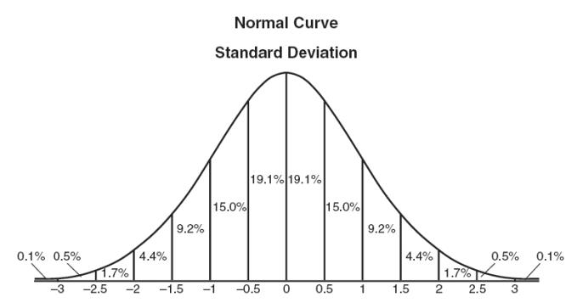
Outliers
Z-Score (parametric)
z = ( x - 𝝻 ) / 𝞂
Notes:
Point: internal errors or anomalies.
Contextual: periodical random measurement errors, external factors that interfere with measures
Collective: change in hose costs in europe before and after the euro.

Slide 10
Outliers
Z-Score pros:
It is a very effective method if you can describe the values in the feature space with a gaussian distribution. (Parametric)
The implementation is very easy (in Python: using pandas and scipy.stats)
Z-Score cons:
It is only convenient to use in a low dimensional feature space, in a small to medium sized dataset.
Is not recommended when distributions can not be assumed to be parametric.
Notes:
Point: internal errors or anomalies.
Contextual: periodical random measurement errors, external factors that interfere with measures
Collective: change in hose costs in europe before and after the euro.

Slide 11
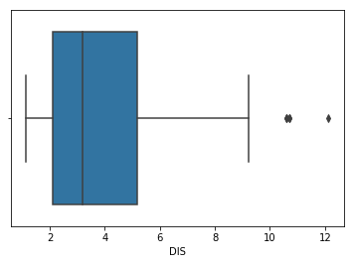
Outliers
Alternative to Z-Score: IQR based Extreme Value Analysis (non-parametric)
Boxplot (Whiskers boxes)
Implementation:
Median ± (IRQ * 1.5)
Notes:
Point: internal errors or anomalies.
Contextual: periodical random measurement errors, external factors that interfere with measures
Collective: change in hose costs in europe before and after the euro.

Slide 12
Outliers
Methods for outlier detection:
Extreme Value Analysis
Proximity Based Models (non-parametric)
High Dimensional Outlier Detection Methods (high dimensional sparse data)
Linear Regression Models (PCA, LMS)
Probabilistic and Statistical Modeling (parametric)
Information Theory Models
Notes:
Point: internal errors or anomalies.
Contextual: periodical random measurement errors, external factors that interfere with measures
Collective: change in hose costs in europe before and after the euro.

Slide 13
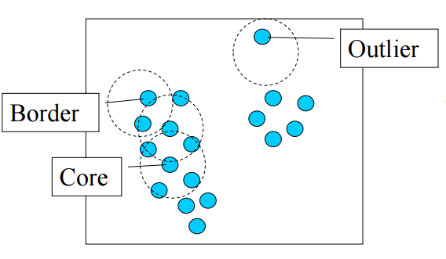
Outliers
Proximity Based Models (non-parametric)
DBSCAN
Determine the minimum number of points in a cluster (numPts) and the radius of our neighborhoods around a data point p (eps).
Search for a random point having at least numPts inside a radius eps. If found, define as a core point.
Search for new random points not in a cluster having at least numPts inside a radius eps. When found all the core points, expand to the border points. Points that are not included are defined as outliers.
Notes:
Point: internal errors or anomalies.
Contextual: periodical random measurement errors, external factors that interfere with measures
Collective: change in hose costs in europe before and after the euro.

Slide 14
Outliers
Proximity Based Models (non-parametric)
DBSCAN Advantages:
Ability to handle outliers (resistant to noise)
Effective method when the distribution of values in the feature space can not be assumed.
Works well if the feature space for searching outliers is multidimensional (ie. 3 or more dimensions)
Easy implementation in R and Python (Scikit learn)
Visualizing the results is easy and the method itself is very intuitive.
Notes:
Point: internal errors or anomalies.
Contextual: periodical random measurement errors, external factors that interfere with measures
Collective: change in hose costs in europe before and after the euro.

Slide 15
Outliers
Proximity Based Models (non-parametric)
DBSCAN Disadvantages:
If there is high variation in the density, noise points are not detected
Sensitive to parameters (hard to determine the correct set of parameters)
The quality of DBSCAN depends on the distance measure.
DBSCAN cannot cluster data sets well with large differences in densities.
Notes:
Point: internal errors or anomalies.
Contextual: periodical random measurement errors, external factors that interfere with measures
Collective: change in hose costs in europe before and after the euro.

Slide 16
Outliers
Methods for outlier detection:
Z-Score or Extreme Value Analysis (parametric)
Proximity Based Models (non-parametric)
High Dimensional Outlier Detection Methods (high dimensional sparse data)
Linear Regression Models (PCA, LMS)
Probabilistic and Statistical Modeling (parametric)
Information Theory Models
Notes:
Point: internal errors or anomalies.
Contextual: periodical random measurement errors, external factors that interfere with measures
Collective: change in hose costs in europe before and after the euro.

Slide 17
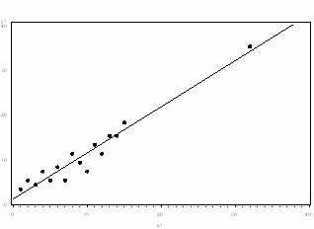
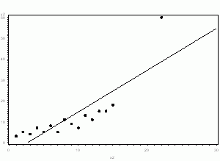
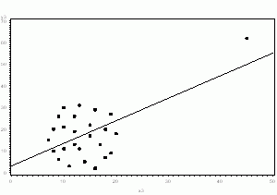
Outliers
If it is obviously due to incorrectly entered or measured data, drop it
If it does not change the results but does affect assumptions, drop it (report!)
If it affects both results and assumptions. Don’t drop it. (Analyze with and without. Report!)
If it creates a significant association, drop it
Treating outliers: To drop or not to drop?
Notes:
Point: internal errors or anomalies.
Contextual: periodical random measurement errors, external factors that interfere with measures
Collective: change in hose costs in europe before and after the euro.

Slide 18
Outliers
Treating outliers: When dropping is not recommended
Truncation (not recommended)
Data transformation: use log or sqrt
Try using non-parametric models (decision trees, Random Forest, etc)
Notes:
Point: internal errors or anomalies.
Contextual: periodical random measurement errors, external factors that interfere with measures
Collective: change in hose costs in europe before and after the euro.

Slide 19
Missingness
Before treating the missing values we have to understand which kind of missing mechanism affects each variable.
The decision on the technique to be used depends on the type of mechanism.
For each variable we have to decide the correct method to be applied

Slide 20
Missing Mechanisms
MCAR
MAR
MNAR
Missing Completely at Random
There is no relationship between the missingness of the data and any values, observed or missing.

Slide 21
Missing Mechanisms
MCAR
MAR
MNAR
Missing at Random
The missingness is random but the proportion of missingness differ depending on other variables or the values of the same variable in past observations.
Notes:
Examples:
In a questionnaire, women will tell his age less frequently than men
Individuals with hypertension will have more blood pressure measures than normal individuals
Individuals with low socio-economic level will buy less their medication.

Slide 22
Missing Mechanisms
MCAR
MAR
MNAR
Missing Not at Random
There is an explanation of why the value is missing
This mechanism is also known as ‘non-ignorable’ missingness
The process of generation of missingness can be modeled and explained
Notes:
In a questionnaire one question has 5 options, but none of the options is appropriate for some individuals and left the question with no answer.
Enterprise policy dictate that clients younger than 25 years will not be asked for their income.

Slide 23
Missing Treatment
Tests for detecting missingness mechanisms
t-test or chi-square between the values of the records with missing values and those without them (Little technique).
Histogram stratified by sub-populations (based on other variables)
Multivariate analysis of missingness (glm)

Slide 24
Missing Treatment
Missingness treatment
Listwise deletion
Categorization
Constant substitution (mean, median, -9999,0)
Model Based
Maximum Likelihood
KNN approximation
Multiple Imputation (MICE=Multiple Imputation by Chained Equations)
MIDAS (Multiple Imputation with Denoising Autoencoders)

Slide 25
Missing Treatment
Missingness treatment
Create a random subsample of the population (learning group)
Use a regression to model the value of X.
Check if the imputed X (X_{imp}) has the same distribution of X and if it has a high correlation with the original X
Use the imputed X_{imp} to model Y

